Slide 1

The Nature of the Church
What is the church?
What is its purpose?
Dr. Rick Griffith • 博士 • 新加坡神学院 • BibleStudyDownloads.org

Slide 2
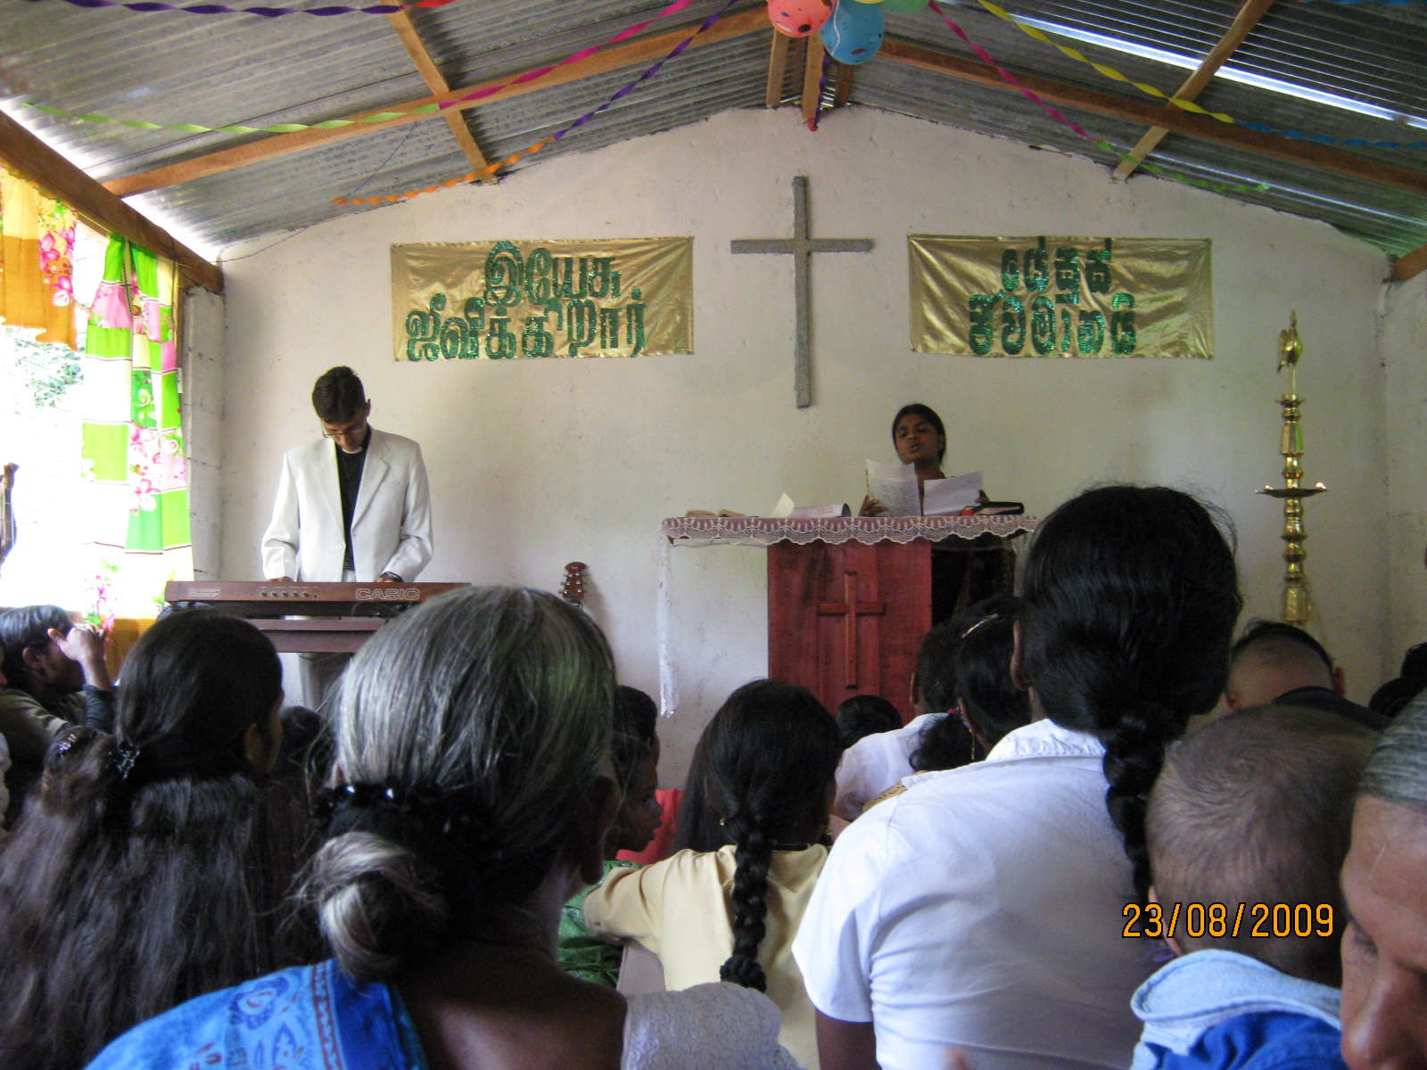
Different Views on the Nature of the Church
7

Slide 3
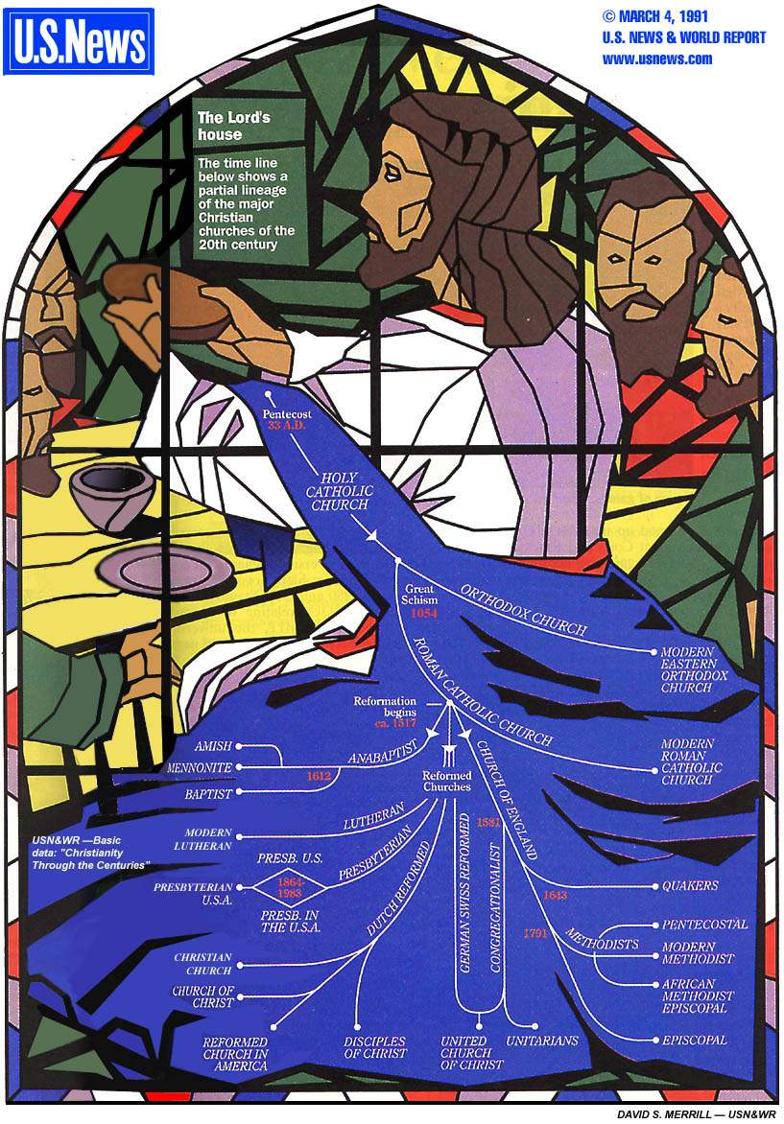
Denominations
This tree of church history depicts the relationships between the various branches of the Christian Church

Slide 4
Denominations
This tree of church history depicts the relationships between the various branches of the Christian Church

Slide 5
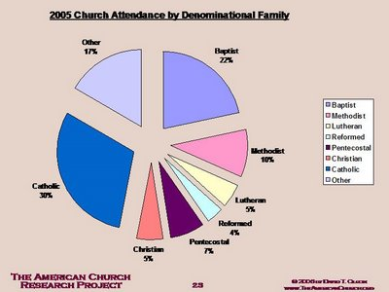
2005 USA Church Attendance
Other
17%
Baptist
22%
Methodist
10%
Catholic
30%
Lutheran
5%
Reformed
4%
Christian
5%
Pentecostal
7%
THE AMERICAN CHURCH RESEARCH PROJECT
© 2005 David T. Olson
http://www.theamericanchurch.org

Slide 6

What is Your Own Definition of the Local Church?
8

Slide 7

A Biblical Definition
9
"The church is the living community of people in Christ Jesus, organized to fulfill corporately a threefold purpose:
worship, edification, and multiplication"
Church Dynamics (BEE World Course), 40.

Slide 8
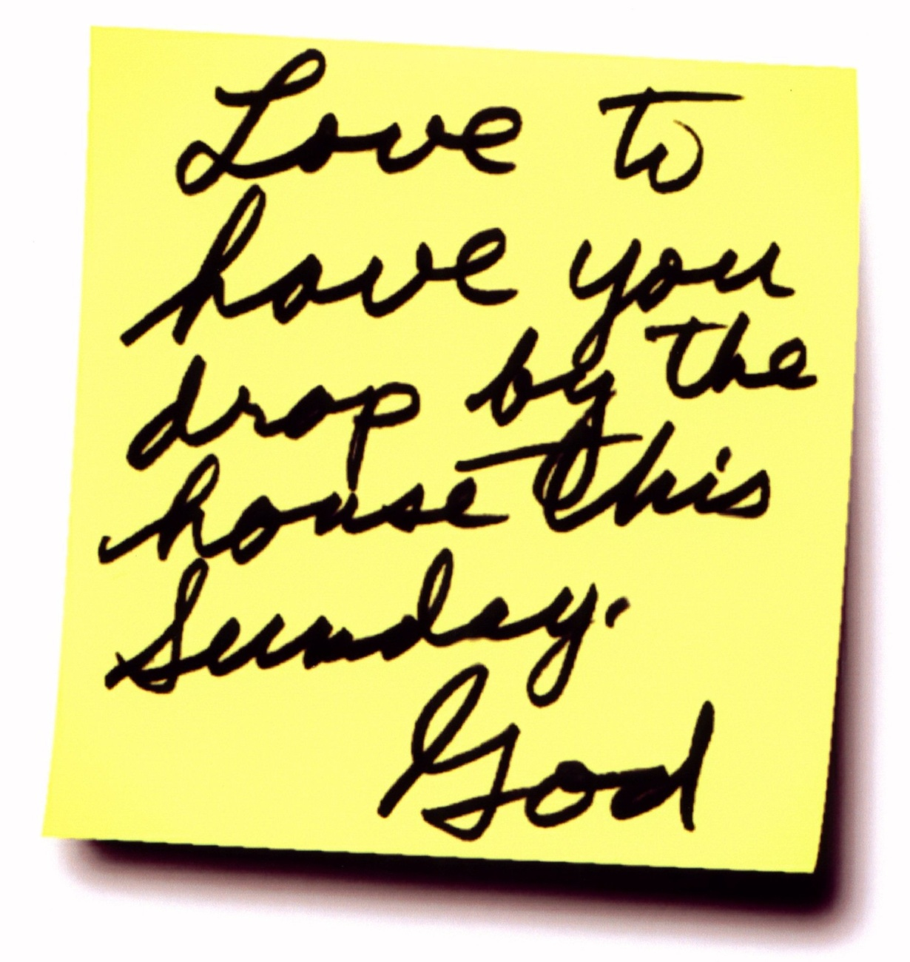
Is the building the "house of God"?

Slide 9
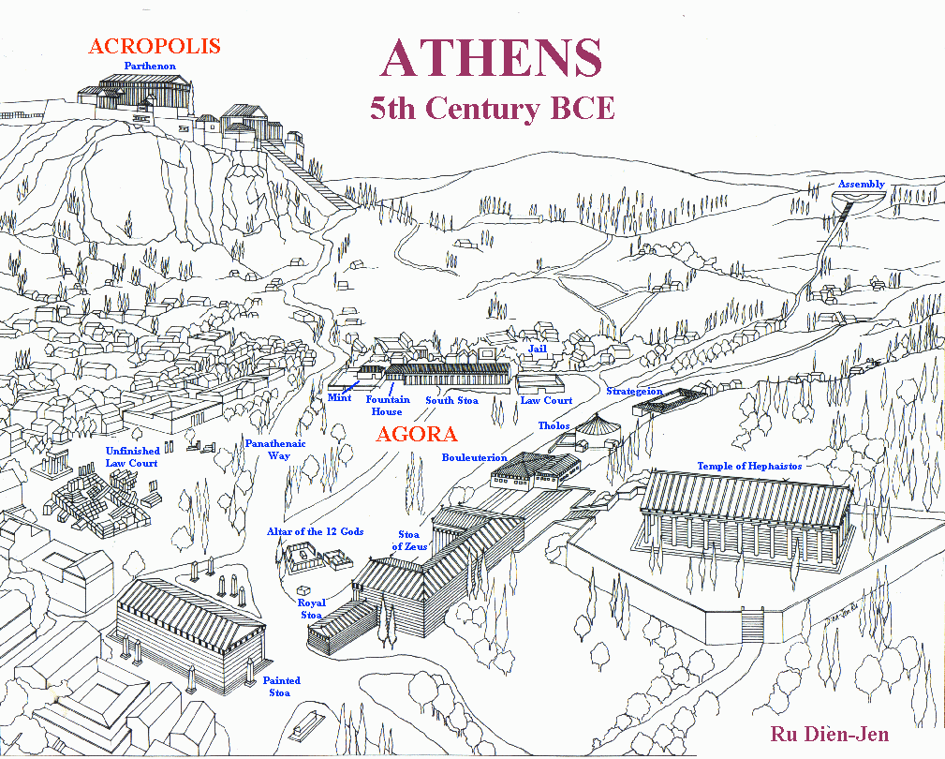
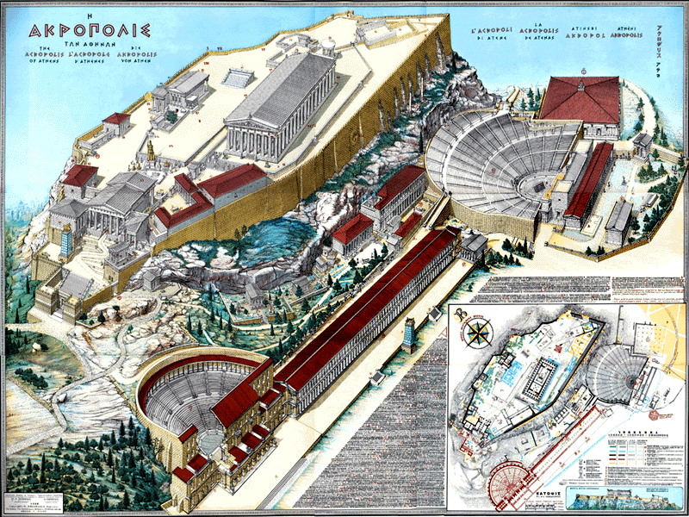
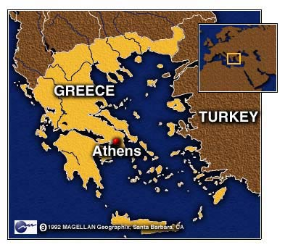
ATHENS
Ecclesia
"被呼招"
Idiotes
"随己意行事"
Kurioikos
“神的家”
“教会” 拉丁文
Notes:
9
The church is a body—not a building.
In ancient Athens, the citizens were very appreciative of their privilege to be a vital part of the city-state—and they recognized their responsibility as well. When a herald would call a meeting of the citizens, each would close his shop, drop what he was doing, and walk out of the city, past the Acropolis and to the next hill for a meeting. This group became known as the ecclesia, or "called out ones."
Some citizens, of course, loved the privileges of being part of the city-state but felt no responsibility for it. They left their shops open and refused to join the ecclesia, so the latter called them idiotes, or ones who did their own thing for selfish purposes. We derive our English word "idiot" from this group of lazy people characterized by self concern and social irresponsibility (CHURCH definition of—"called out ones" by Stuart Briscoe, Singapore missionary retreat, 92).
For the first three centuries of Christianity, the body of believers was always called the ecclesia. Only in the time of Constantine in the 4th century did the term kurioikos, "house of the Lord," come about, from which through the Latin we arrive at our English word "church." The early Christians never associated themselves with a building called the "church" (CHURCH body, not a building by W.A. Criswell at DTS chapel). They saw themselves only as the ecclesia, or "called out ones"—called out from the world to be God's own people!

Slide 10

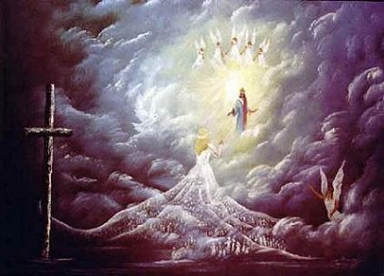
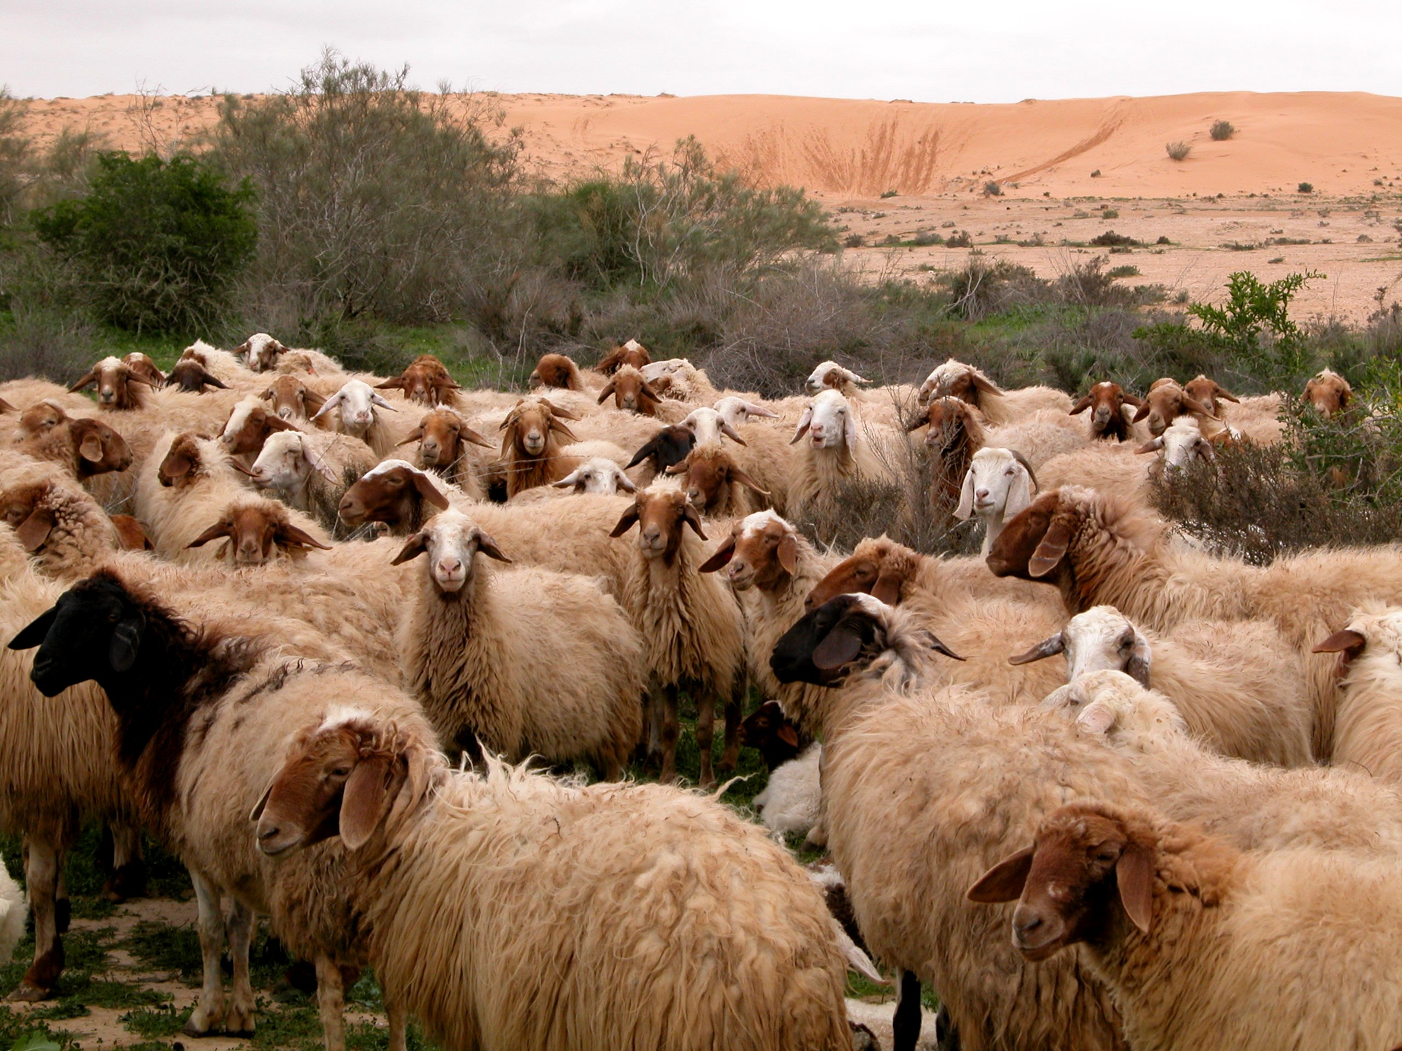
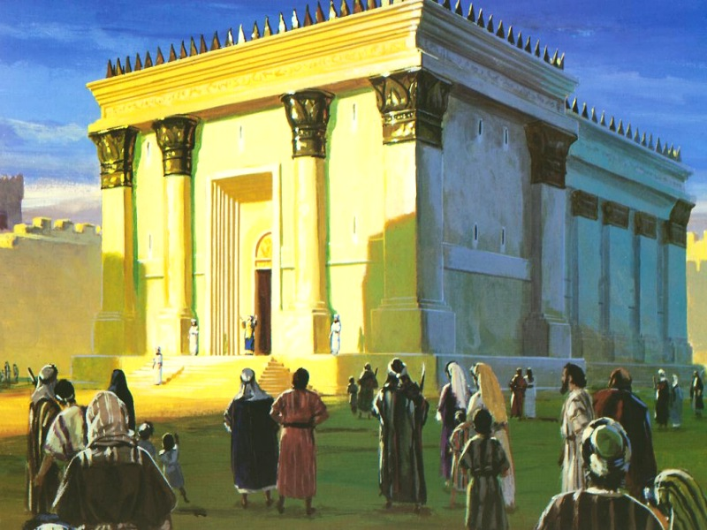
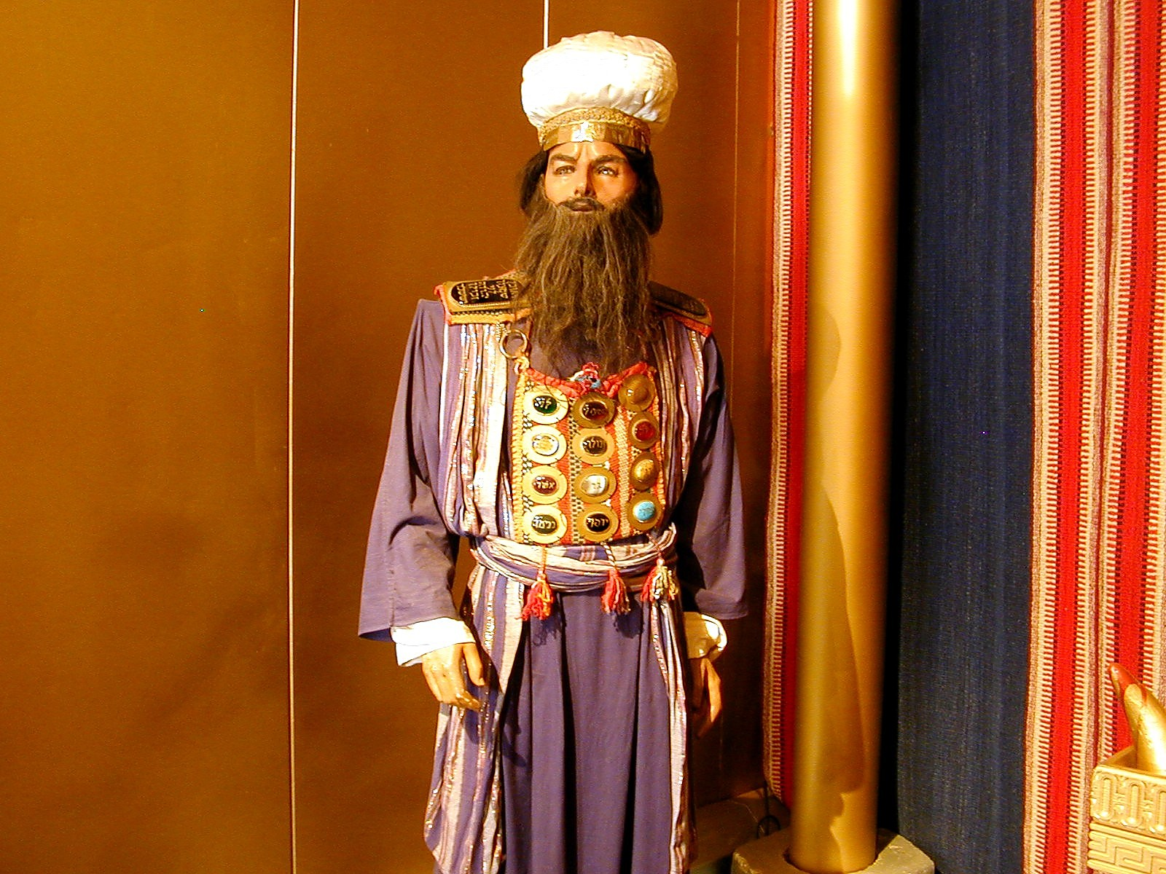
Five Church Metaphors
10
10
Ministry of Christ
(What does the metaphor teach about Jesus?)
Ministry of Church
(What does the metaphor teach about us?)
Applications
(How does grasping this metaphor help our ministry?)
Purposes
Does the metaphor emphasize worship, edification, multiplication or a combination of these purposes?
Notes:
10
Break into 5 groups, each studying one of the metaphors. Fill in your own row to answer the meaning of the metaphor in the three blank columns, including the purpose for the church that this metaphor describes: worship, edification and/or multiplication.

Slide 11
Body
10
10
Ministry of Christ
(What does the metaphor teach about Jesus?)
Ministry of Church
(What does the metaphor teach about us?)
Applications
(How does grasping this metaphor help our ministry?)
Notes:
11

Slide 12
A. 在教会里，每个人都有不同恩赐。(12:14)
一个身体，
许多肢体。
Notes:
12

Slide 13
II. 我们需要运用恩赐，使教会能够运作(12:14-20)
155dd
发言 | 服侍 （行动）
教导 | 行政
传福音 | 信心
牧师/教师 | 给予
鼓励 | 服侍
 | 怜悯
Notes:
13

Slide 14
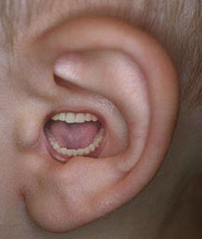
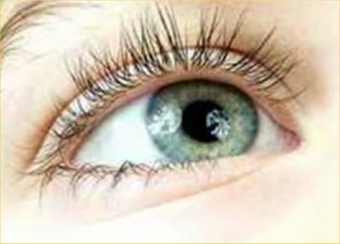
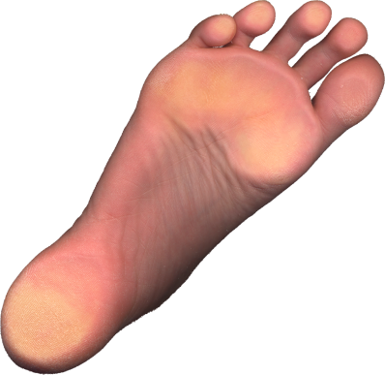


B. 拥有比较不起眼的恩赐的信徒，不因该认为自己不重要。 (12:15-16).
¹⁵ 设 若 脚 说 ,
"我不是手，所以不属乎身子；他不能因此就不
属乎身子。"
他不会因此而废弃成为基督身体中的一部分。
¹⁶ 设 若 耳 说 ：
"我不是眼，所以不属乎身子；他也不能因此就
不属乎身子。"
他不会因此而废弃成为基督身体中的一部分。

Slide 15

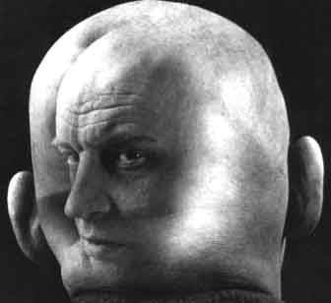
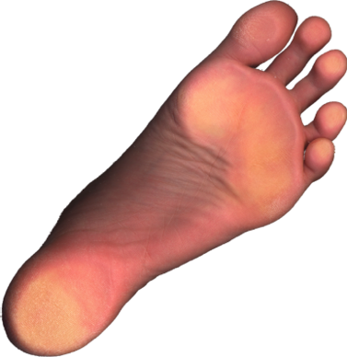
信徒不因该对其他的比较不起眼的肢体说,
“我不需要你！”(12:21)
"眼睛不因该对手说,
"我不需要你!"
而头不因该对脚说,
"我不需要你!"

Slide 16
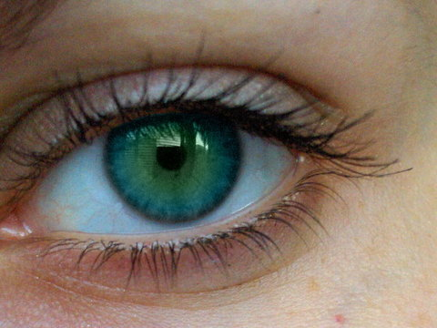
C. 在教会的多样性，使他更有效率
(12:17-20).
¹⁷假如整个身体只是眼睛，怎样听呢？假如整个身体只是耳朵，怎样闻味呢？ ¹⁸ 但现在 神按照自己的意思，把肢体一一放在身体上。 ¹⁹ 假如所有的只是一个肢体，怎能算是身体呢？ ²⁰ 但现在肢体虽然很多，身体却只是一个。

Slide 17


III. 因当谦卑地使用属灵恩赐(12:21-26).
Notes:
17

Slide 18
看似卑微的恩赐，更不能少
(12:22)
²²不但如此，身上肢体人以为软弱的，更是不可少的。
Notes:
18

Slide 19
看似不体面的恩赐，更要尊荣他
(12:23a)
²²不但如此，身上肢体人以为软弱的，更是不可少的。²³ 身上肢体， 我们看为不体面的，越发给他加上体面
Notes:
19

Slide 20
恩赐看似不 俊 美 的 ， 越 发 得 着 俊 美(12:23b)
…不大美观的部分，就更加要使它美观。
Notes:
20

Slide 21
拥有出众的恩赐的信徒，
我们无须特别肯定他(12:24a)
²⁴我们身体上美观的部分，就不需要这样了。
Notes:
21

Slide 22
神会加倍尊荣那些默默在幕后服侍的肢体(12:24b).
但 神却这样把身体组成了：格外地把体面加给比较有缺欠的肢体
Notes:
22

Slide 23
神看重每一个肢体，我们也要彼此相顾(12:25-26).
²⁵好使肢体能够互相照顾，免得身体上有了分裂。 ²⁶ 如果一个肢体受苦，所有的肢体就一同受苦；如果一个肢体得荣耀，所有的肢体就一同快乐。
Notes:
23

Slide 24
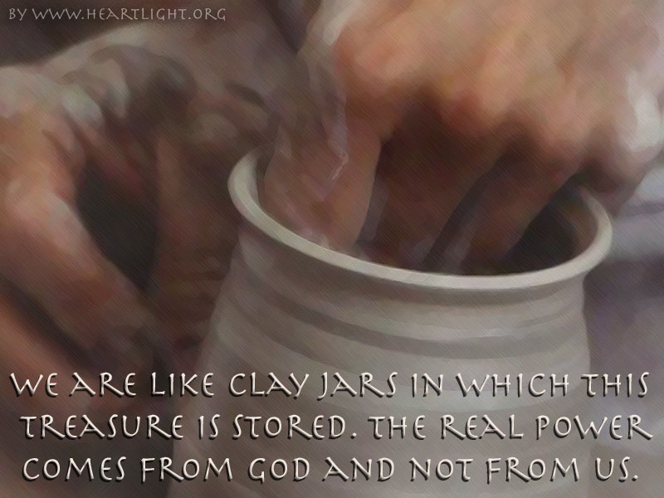
IV. 教会需要不同恩赐的配搭，使得教会多元化。 (12:27-31).
我 们 有 这 宝 贝 放 在 瓦 器 里 ， 要 显 明 这 莫 大 的 能 力 是 出 於 神 ， 不 是 出 於 我 们 。
Notes:
24

Slide 25
B. 不同的阶层，有不同的恩赐，说明信徒各有不同恩赐。
(12:28-30).
神 在 教 会 所
设 立 的 ：
第 一 是 使 徒 ，
第 二 是 先 知 ，
第 三 是 教 师 ，
其 次 是 行 异 能 的 ， 再 次 是 得 恩 赐 医 病 的 ， 帮 助 人 的 ， 治 理 事 的 ， 说 方 言 的 。
岂 都 是 使 徒 么 ？ 岂 都 是 先 知么？ 岂 都 是 教 师么？
岂 都 是 行 异 能 的么？岂 都 是 得 恩 赐 医 病 的么？
岂 都 是 说 方 言 的么？ 岂 都 是 翻 方 言 的么？
Notes:
25

Slide 26
C. 渴慕恩赐的目的是要来
造就教会(12:31).
林前12:31 林前12:31 “切 切 的 求 那 更 大 的 恩 赐”
“每个人切 切 的 求 ” = “每个人”
“更 大 的 恩 赐” = 28 节
Notes:
26

Slide 27
Bride
10
10
Ministry of Christ
(What does the metaphor teach about Jesus?)
Ministry of Church
(What does the metaphor teach about us?)
Applications
(How does grasping this metaphor help our ministry?)
Notes:
27

Slide 28

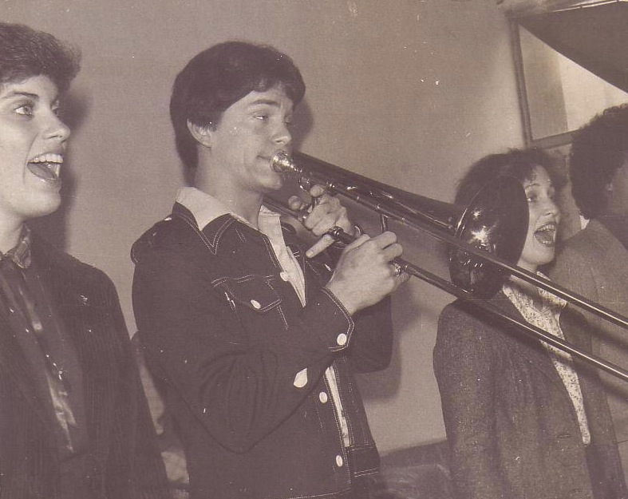

Susan & Rick, 1982
Notes:
God also began to open my eyes to the woman singing next to me! She initially despised me but after a year or so she saw the light. That's our engagement picture. In 1983 we returned to the USA..

Slide 29
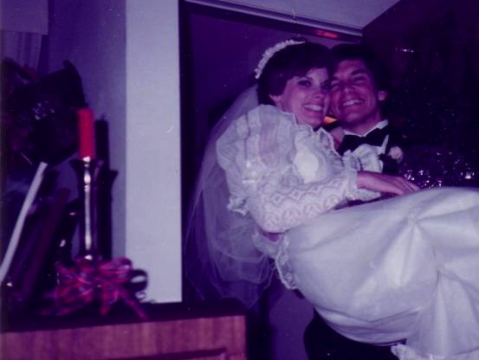
Marriage:
30 December 1983
Notes:
I married her and took her to Dallas Seminary a few days later. Three years later our first son was born on his grandpa's 70th birthday, so we named him Kurt in honor of Susan's father. I also pastored a church, had a ministry to international students, and served as a chaplain.

Slide 30
Temple
10
10
Ministry of Christ
(What does the metaphor teach about Jesus?)
Ministry of Church
(What does the metaphor teach about us?)
Applications
(How does grasping this metaphor help our ministry?)
Notes:
30

Slide 31

神的家庭 (弗 2:19-22)
19
非装备的恩赐
(弗 4:12b)
牧师－教师
传道
教师
装备的恩赐
(弗 4:11-12a)
根基: 使徒 和 先知 (弗. 2:20)
根基: 主耶稣基督 (林前. 3:11)
Adapted from Charles R. Swindoll. "Spiritual Gifts Study Guide" (IFL, 1983), 7

Slide 32
Priesthood
10
10
Ministry of Christ
(What does the metaphor teach about Jesus?)
Ministry of Church
(What does the metaphor teach about us?)
Applications
(How does grasping this metaphor help our ministry?)
Notes:
32

Slide 33
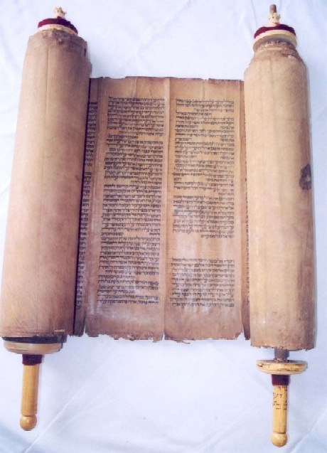
Priesthood
in Old Testament Times

Slide 34
Levi's Family Tree
LEVI
Gershon
Kohath
Merari
Levites
Amram
Priests
High Priest
Mariam
Aaron
Moses
Offered
Unauthorised Fire;
Killed by God
Nadab
Abihu
Eleazar
Ithamar

Slide 35
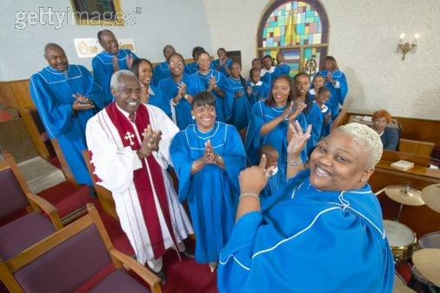
The Priesthood of believers

Slide 36
Flock
10
10
Ministry of Christ
(What does the metaphor teach about Jesus?)
Ministry of Church
(What does the metaphor teach about us?)
Applications
(How does grasping this metaphor help our ministry?)
Notes:
36

Slide 37
Metaphors for the Church
10
Metaphor & Text | Ministry of Christ | Ministry of Church | Applications
Body • 1 Cor. 12 • Col. 1:18 | Sustains church for unity LIFE of Christ | Depends upon Christ Worship, edification | Let diversity within unity focus on Christ as the common source
Bride • Eph. 5:25-27 • Eph. 3:18-19 • 2 Cor. 11:2 | Depth of love Bridegroom (Christ) has for Bride (Church) LOVE of Christ | Purifies herself to show her love Worship, edification | Prepare to meet Christ as a bride prepares for her wedding
Building/Temple • Eph. 2:21-22 • 1 Pet. 2:4-6 • 1 Cor. 3:10-11 | Foundation Stone for growth who indwells each believer PRESENCE of Christ | Grows together as all believers build on the foundation Worship, edification, multiplication | Maintain unity so as not to dishonor Christ's presence

Slide 38
Metaphors for the Church
10
Metaphor & Text | Ministry of Christ | Ministry of Church | Applications
Priesthood • 1 Pet. 2:5-9 • Rev. 1:4-6 • Rev. 5:9-10 • Rev. 20:6 | Accepts worship from every Christian DEITY of Christ | Each believer should offer a sacrifice of praise to God as a witness to the world Worship, multiplication | No real clergy-laity distinction exists
Flock • Acts 20:28 • 1 Pet. 5:4 • John 10:11, 14 | Cares for sheep as the Good Shepherd CARE of Christ | Focus on needs of sheep rather than ministry: rest, food, guidance, encouragement, healing, etc. Edification | Remain within the flock for protection and care from the Shepherd

Slide 39

Three Purposes for the Church
14
WORSHIP
To Christ
Body
EDIFICATION
To Believers
Bride
Building
Flock
Priesthood
MULTIPLICATION
To Unbelievers

Slide 40
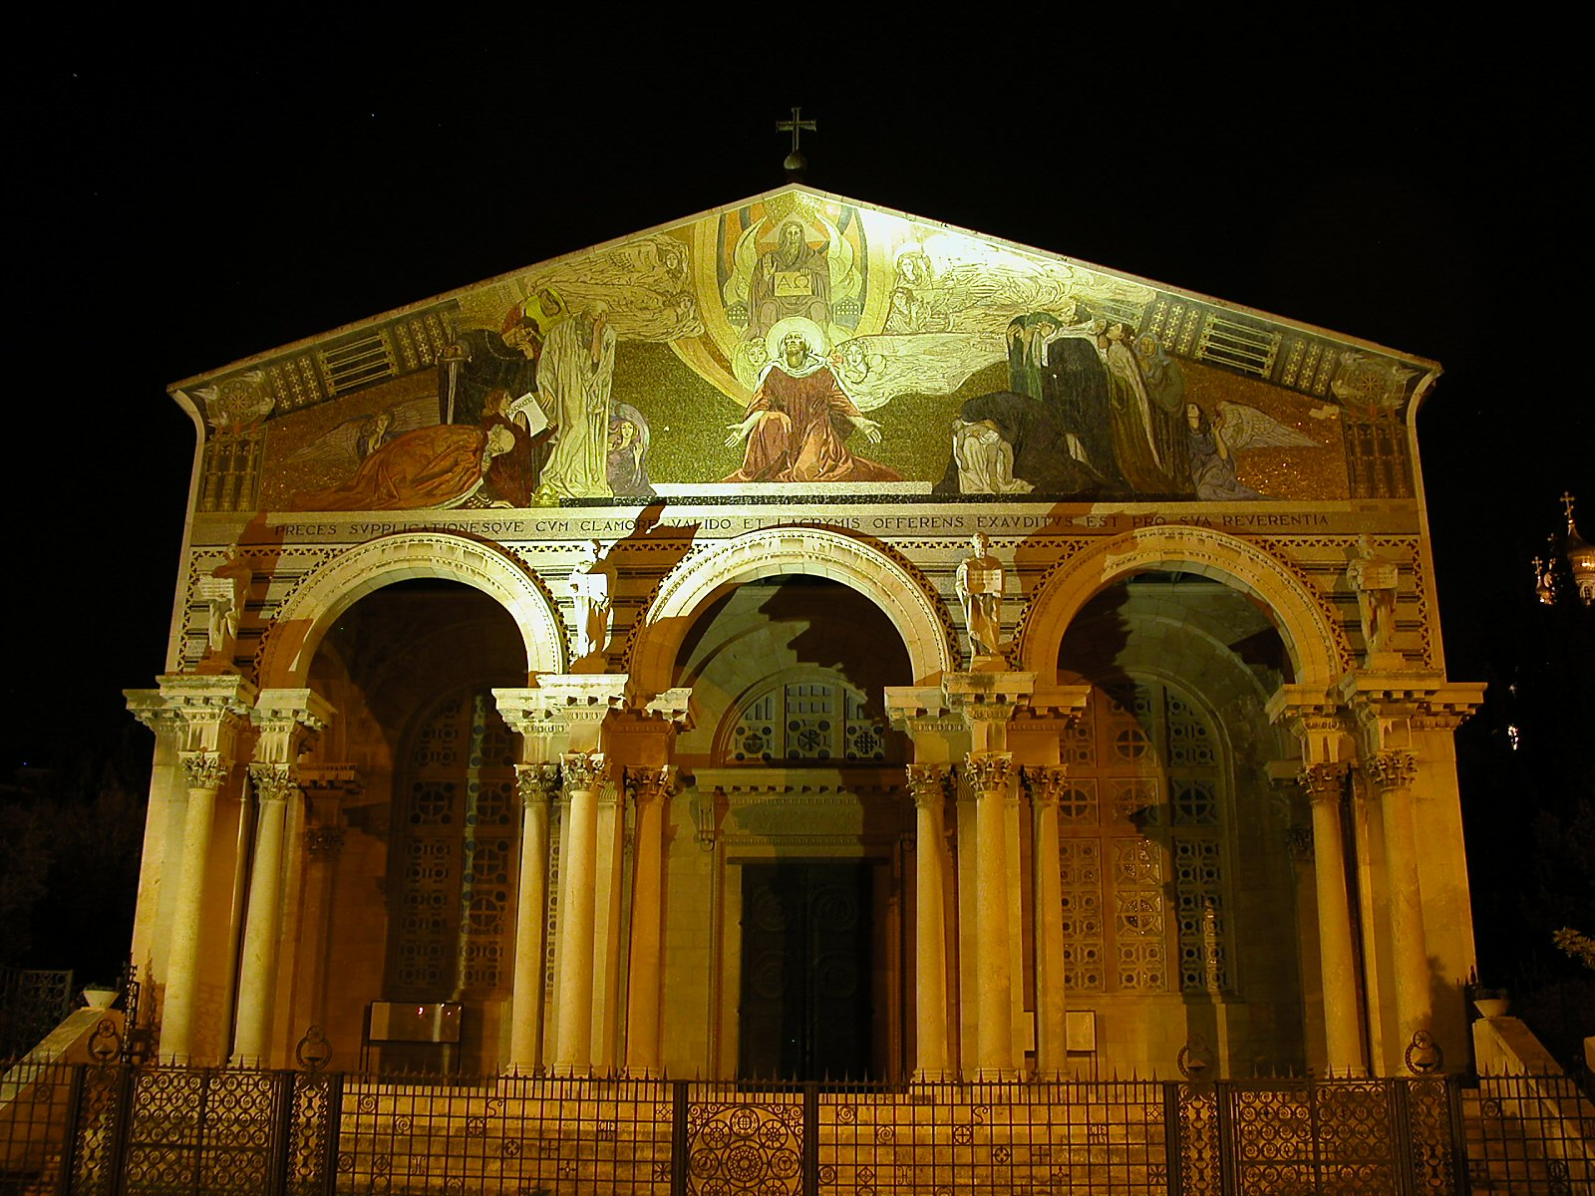
Other Metaphors for the Church...
15
The Church of All Nations
(nighttime in Jerusalem)

Slide 41

The Branch Metaphor in John 15…
15

Slide 42

I am the Vine… (15:1)
15

Slide 43
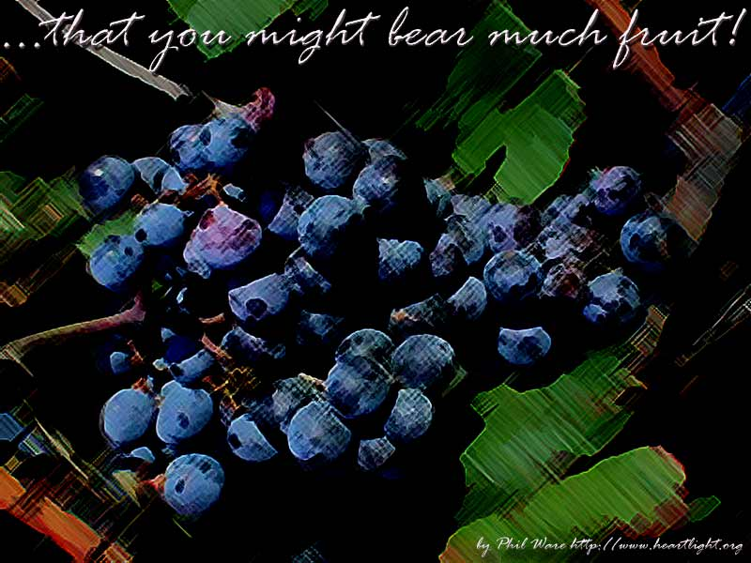
What is the "fruit"?
15

Slide 44
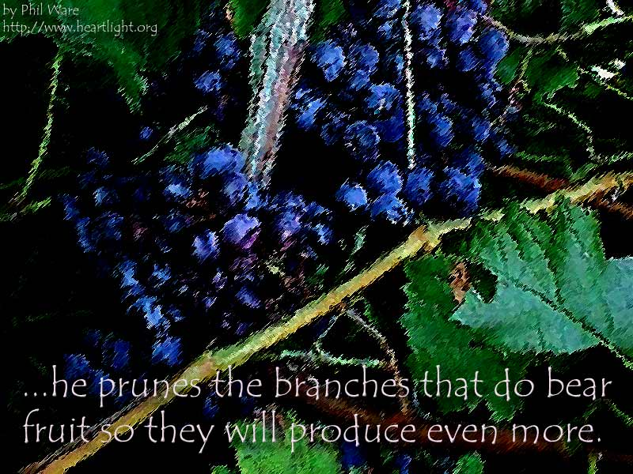
The pruning metaphor is not easy to understand...
15

Slide 45

John 15:2
15
"He cuts off (lifts up) every branch in me that bears no fruit
while every branch that does bear fruit he prunes so that it will be even more fruitful."

Slide 46
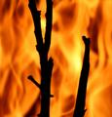
But what is the branch thrown away and burned in verse 6?
15

Slide 47

A Closer Look at John 15:1-6
Issues | Arminian | Calvinist | Partakers | Derickson
"The Father ai;rw" (2a) | "cuts off" = loses salvation | "cuts off" = disciplines | "lifts up" = cares for | "lifts up" = cares for
"branch… that does not bear fruit" (2b) | Christian who stops believing | Unbeliever who never believed | Christian who stops believing | Christian who stops believing
"in me" (2c) | Adjective that modifies the noun: "branch in me" | Adverb that modifies the verb: "does not bear fruit in me" | Adjective that modifies the noun: "branch in me" | Adjective that modifies the noun: "branch in me"

Slide 48
A Closer Look at John 15:1-6
Issues | Arminian | Calvinist | Partakers | Derickson
"The Father prunes" (2d) | Discipline of believers in contrast to judgment of former believers in v. 2a | Discipline of believers in contrast to judgment of professing believers in v. 2a | Discipline of believers in same sense as loving care of believers in v. 2a | Discipline of believers in same sense as loving care of believers in v. 2a
"You are already clean" (3) | Saved | Refers only to disciples' salvation? | Saved | Saved
"thrown away & burned" (6) | Judgment by loss of salvation | Judgment by never having salvation | Discipline by death and loss of rewards | Loving care to gain fruitful-ness

Slide 49

A Suggested John 15 Sermon
15
Subject: How can you be most effective for Christ?
Depend on Christ (15:1-11)
Love other believers (15:12-17)
Accept hate from the world (15:18–16:4)

Slide 50

What is your
"fruit that will last"?
15

Slide 51

The Church as a Kingdom
祂救了我们脱离黑暗的权势，
把我们迁到祂爱子的国里，
我们在爱子里得蒙救赎，罪过得以赦免。
(歌罗西书1:13-14)
12

Slide 52
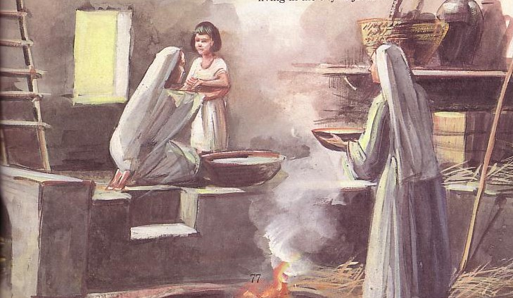
The Church as a Household/Family (Eph. 2:19)
15

Slide 53

Summary
"Every biblical metaphor of the church, without exception, emphasizes its unity. The church is one bride with one husband; one flock with one shepherd; one set of branches on one vine; one kingdom with one king; one family with one father; one building with one foundation; one body with one head, Jesus Christ."
John MacArthur, The Church: The Body of Christ (Grand Rapids: Zondervan, 1973), 19.
Notes:
53

Slide 54
How is Your Church in the Three Purposes?
15
WORSHIP
To Christ
EDIFICATION
To Believers
Is your church body giving God his worth or just attending services?
How well are the believers ministering to one another?
MULTIPLICATION
To Unbelievers
How well is your church growing numerically?

Slide 55
Function versus Form
16
Function | Form
What to do | How to do it
Absolutes | Non-absolutes
Directives | Methods
Unchanging | Changing
Principles | Pattern
Notes:
55

Slide 56
Function versus Form
16
Function | Form
Organism | Organization
Truth | Tradition
Learning | Doing
Instruction | Implementation
Vision | Process
Notes:
56

Slide 57
Function versus Form
16
Function | Form
Message | Method
Studied first | Enacted Later
Supra-cultural | Cultural
Command Given | Command Obeyed
Meet together (Heb. 10:24-25) | Home groups, cells, services, etc.
Notes:
57

Slide 58
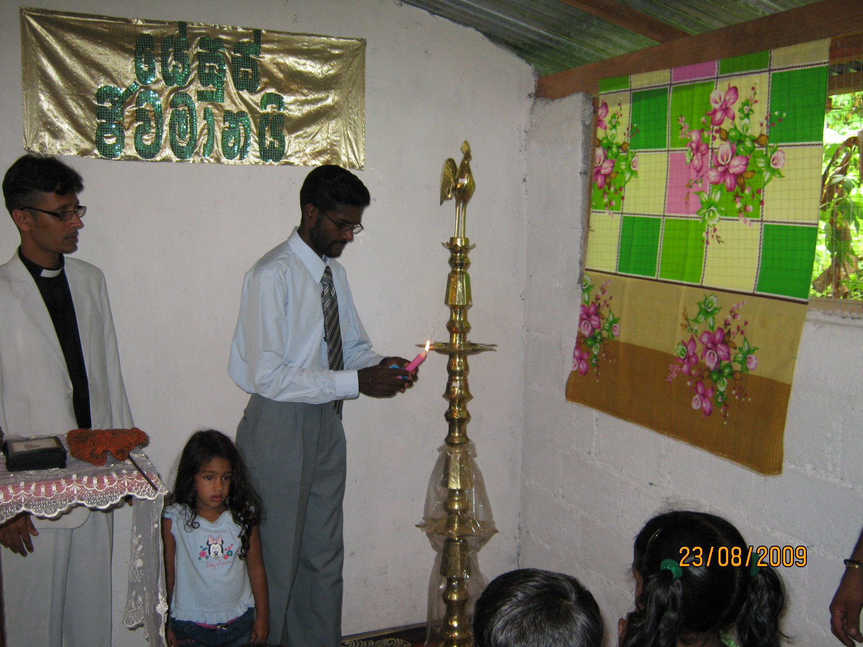
Now let's evaluate some church practices...
17
The following is adapted from the Church Dynamics Course Guide (BEE World: Colorado Springs), 55

Slide 59
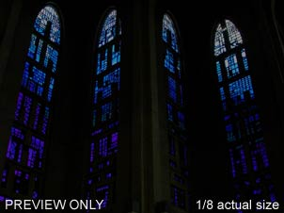
Supra Cultural or Cultural?
17
S
C
C
Celebrating the Lord's Supper with white bread and red wine
Celebrating the Lord's Supper on Sunday
Celebrating the Lord's Supper in a church building
Celebrating the Lord's Supper
Having a Sunday school
The pastor wearing a tie at church
C
C
S
C
C

Slide 60
Supra Cultural or Cultural?
17
C
The pastor receiving a full salary from the congregation
Having a choir during worship services
Guitar accompaniment in worship services
Handing out gospel tracts to unbelievers
Caring for the sick and discouraged among the church membership
C
C
C
S

Slide 61
Supra Cultural or Cultural?
17
C
Calling the main preacher "Rev." or pastor
Meeting regularly in small groups for prayer and Bible study
Instructing believers to regularly memorize verses of Scripture
Main church worship services on Sunday
Church leadership by a group of elders
Head coverings for women during worship
S
C
C
S
C

Slide 62

Steps to Relevance
(Applying the Right Form for the Function)
18
How can we truly have an indigenous church—relevant both to the Bible as well as to the culture? What are some helpful principles to apply to a certain practice?
The following is adapted from the Church Dynamics Course Guide (BEE World: Colorado Springs), 63-65

Slide 63
Steps to Relevance
(Applying the Right Form for the Function)
18
a) Clarify in your own mind whether the Bible commands or prohibits a certain practice (see the examples immediately above). If so, then you must obey Scripture over culture.

Slide 64
Steps to Relevance
(Applying the Right Form for the Function)
18
b) Even if Scripture allows a practice, it may not be best suited to your own particular culture, so evaluate the culture in which your church ministers.

Slide 65
Steps to Relevance
(Applying the Right Form for the Function)
19
c) Ask not "what do I do" but "why do I practice this method, custom, or tradition?" Knowing the reason will help you to see if you are following a biblical command or simply carrying on a tradition for its own sake.

Slide 66
Steps to Relevance
(Applying the Right Form for the Function)
19
Be willing to change—even eager to change! Are you flexible to change anything that is not biblically mandated?
Discuss with your leaders the need for change until they agree that it is God's timing.

Slide 67
Steps to Relevance
(Applying the Right Form for the Function)
19
f) Teach the people within the church the biblical and cultural rationale for the necessary change, noting that the entire church leadership agrees.

Slide 68
Steps to Relevance
(Applying the Right Form for the Function)
19
g) Prayerfully implement the needed change while simultaneously getting feedback from the people.

Slide 69

Evaluating Function & Form
19
What are the various activities of my regular church ministry?
Which of these activities should never be changed because they are biblical?
Which timeless biblical principles are not being implemented in my ministry?
Notes:
69

Slide 70
Evaluating Function & Form
20
What can I learn from history that would benefit my ministry today?
What practice am I treating as if it is supra cultural even though it is cultural? What long-term effect can this have on my ministry?
Notes:
70

Slide 71
Evaluating Function & Form
20
What is the single most important task that I must carry out to accomplish my God-given ministry? What is second?
Notes:
71

Slide 72


问题: 以色列与教会：
无连续 或是 连续 ?
回答: 两者皆是!
(参阅 新约导论 155r-155s页)

Slide 73

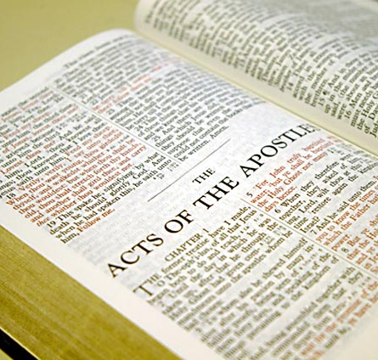
But why is Distinguishing
Israel & the Church Significant?
22
Does the Mosaic Law apply today?
Should we spiritualize Scripture?
Notes:
73

Slide 74


两种约的对照
116
 | 亚伯拉罕 | 摩西
接受者 (日期与 地点) | 公元前2060年迦勒底吾珥，亚伯拉罕为众国的中保 | 公元前1445 年于西乃山 ，摩西为以色列人的中保
经文 | 创 12：1-3 (在创15章正式为约) | 出20-31章是约的核心
神与 | 一个人 (为将来的国)立约 | 一个国立约
范围 | 普世性 (“万族都要因你得福”) | 惟有以色列人领受律法 (申 4:8; 诗147:20)

Slide 75
两种约的对照
116
 | 亚伯拉罕 | 摩西
应许 | 土地, 后裔 和祝福 (没有说明履行时间) | 遵行得福，背道受咒诅 (未 26; 申 28)
条件 | 无条件: “我必…” | 有条件: “你们若…我就…”
参与 | 亚伯拉罕沉睡 (创 15:17) | 以色列同意守约 (出19:8)
比喻 | 父亲对子(神的特许) | 君主 (强国国王) 对附庸 (附庸国)

Slide 76
两种约的对照
116
 | 亚伯拉罕 | 摩西
形式 | 口传 (无文字记录) | 记录在石板和摩西五经上
重心 | 赐福胜于惩戒/审判(在创12：1-3的“五福”) | 惩戒/审判胜于赐福 (对照 申 28:1-14 与 28:15-68)
基督论 | 耶稣是终极的大卫后裔 （创 12:3） | 耶稣为大祭司(来 8–10)
记号 | 行割礼(创 17:11) | 守安息日(出31:13, 17)

Slide 77
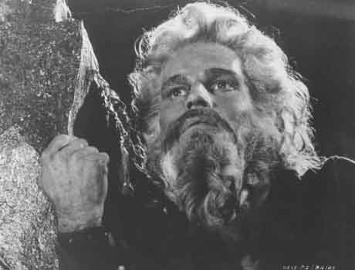
摩西之约
的核心就是十 诫

Slide 78
出 25-31 章
7
律法 (TORAH)
敬虔教育的三个方面:
道德: 十诫 — 现今法律系统的根基
民事: 人民如何在新的社会结构中
彼此相处
礼仪：人民如何在新的社会结构中
敬拜上帝
十戒是否是道德律？
摩西
出埃及
西奈山
德 – 民 – 礼
40
学生手册第26-29页
13

Slide 79
十诫
113a
#
旧约的十诫
新约的重复
1
神吩咐这一切的话说：“我是耶和华你的神,曾将你从埃及地为奴之家领出来. 除了我以外，你不可有别的神。(出 20:1-3).
诸君，为甚么做这事呢?我们也是人，性情和你们一样！我们传福音给你们是叫你们离弃这些虚妄，归向那创造天、地、海和其中万物的永生神。
(徒 14:15; 提到至少50次).
2
“不可为自己雕刻偶像;也不可作什么形象仿佛上天,下底和地底下,水中的百物. … 因为我… 是忌邪的神…我必追讨他的罪,自父及子 … 爱我,守我诫命 ,我必向他们发慈爱,直到千代” (出 20:4-6).
“小子们哪,你们要自首,远避偶像” (约一5:21; 参 帖前 1:9; 启 2:14, 20; 9:20; 在新约提了12次).
* 图表来源：Lewis Sperry Chafer, 系统神学, 4:209-10
3
“不可妄称耶和华你神的名;因为妄称耶和华名的,耶和华必不以他为无罪.” (出 20:7).
“我的弟兄们，最要紧的是不可起誓。不可指著天起誓，也不可指著地起誓，无论何誓都不可起。你们说话，是就说是，不是就说不是，免得你们落在审判之下”
(雅 5:12; 四次).
Notes:
79

Slide 80
十诫
113a
#
旧约的十戒
新约的重复
4
“当记念安息日，守为圣日。六日要劳碌做你一切的工，但第七日是向耶和华你神当守的安息日。这一日你和你的儿女、仆婢、牲畜，并你城里寄居的客旅，无论何工都不可做,因为六日之内，耶和华造天、地、海和其中的万物，第七日便安息，所以耶和华赐福与安息日，定为圣日。” (出 20:8-11).
新约没有记载这个需要.
可是, 一处 经文明确禁止这个需求: “所以不拘在饮食上,或节期、月朔、安息日，都不可让人论断你们。 这些原是后事的影儿，那形体却是基督.” (西 2:16-17; 0x).
5
“当孝敬父母，使你的日子在耶和华你 神所赐你的地上得以长久. ” (出 20:12).
“你们作儿女的，要在主里听从父母，这是理所当然的。要孝敬父母，使你得福，在世长寿。这是第一条带应许的诫命。”
(弗 6:1-3; 太 15:4-6; 19:19; 可 7:10; 10:19;
出现六次).
6
“不可杀人。” (出 20:13).
“凡恨他弟兄的，就是杀人的；你们晓得凡杀人的，没有永生存在他里面。 ”
(约一3:15; 参 太 19:18; 可
10:19; 路 18:20; 罗13:9; 雅 2:11; 出现六次).
Notes:
80

Slide 81
十诫
155l
#
旧 约 的 命 令
新 约 的 重 复
7
“不可奸淫。” (出廿:14)
“婚姻，人人都当尊重，床也不可污秽；因为苟合行淫的人，神必要审判。”
(希十三:4; 参可十:19; 十二次).
律法(十诫)已经完成它的工作， 藉着“不可贪心”
显明人的罪（罗七：7），信徒因着与基督联合
就向该律法死（七：4，6）。既然十诫是一个整体，
基督徒也当在其他的九条诫命上死。
8
“不可偷盗。” (出廿:15)
“从前偷窃的，不要再偷；总要劳力，亲手做正经事，就可有馀分给那缺少的人。 ”
(弗四:28; 参太廿七:64; 可十:19; 路十八:20; 罗十三:9; 多二:10; 六次).
9
“不可作假见证陷害人。” (出廿:16)
“不要彼此说谎；因你们已经脱去旧人和旧人的行为，”
(西三:9; 参弗四:25; 四次).
10
“不可贪恋人的房屋；也不可貪恋人的妻子、仆婢、牲畜，並他一切所有的。”
(出廿:17).
“於是对众人说：你们要谨慎自守，免去一切的贪心，因为人的生命不在乎家道丰富。” (路十二:15; 罗七:7; 十三:9; 弗五:3; 雅四:2; 彼后二:3, 14; 九次).

Slide 82
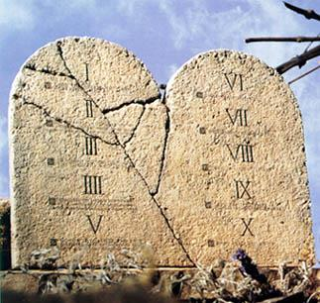
小组讨论…
在哪些方面,今日信徒仍然试图按照摩西的律法生活?
守安息日
食物的律法
十一奉献
不向基督徒收取利息
割礼

Slide 83
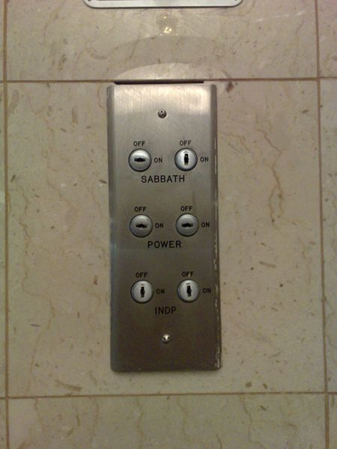
我们在加利利酒店遇上安息日
我们在安息日到达入住的酒店，因电梯停止载客，我们不得不自行提着行李爬上两层的楼梯以此庆祝我们的休息日。
Notes:
在我2007年之旅，我率领以色列，电梯被设定到的安息日狀態，这意味着只会每四楼停下。

Slide 84

罗马书里的义
145
主题 | 需要 | 供应 | 传授 | 证实 | 应用 | 传播
序言 1:1-17 | 定罪 1:18– 3:20 | 称义 3:21– 5:21 | 成圣 6–8 | 拣选 9–11 | 更新 12:1– 15:13 | 宣教 15:14– 16:27
开始 | 犯罪 | 救恩 | 分别为圣 | 主权 | 服事 | 差遣

Slide 85

“以色列”始终是指雅各的肉身后裔 (9:1-5)
155v
“因为从以色列生的不都是以色列人” (9:6)
≠ “以色列”指信主的外邦人?!?!
= 不是所有犹太人相信

Slide 86

以色列民族有未来吗?
155q

Slide 87
总结罗马书9-11章
154d
9:1-29 | 9:30–10:21 | 11:1-36
以色列的过去 | 以色列的现在 | 以色列的将来
神拣选以色列 | 以色列拒绝神 | 神只将部分且暂时拒绝以色列
以色列的失败并非因为神是不信实 | 以色列的失败是因为他们拒绝弥赛亚 | 以色列的失败将不是大范围的也非最终的
犹太余民被神所存留 | 但是这犹太余民现在仍抗拒他 | 这部分余民将增长成为全民信主
外邦人在基督里亦成为神的选民 | 外邦人现在因信基督而得蒙拯救 | 外邦人不应蒙受了犹太人所拒绝的福而骄傲
神方面 | 人方面 | 神圣结果
神的拣选 | 人的责任 | 神的怜悯
人的不信并不能摧毁神的应许因为应许是建立在神主权性的拣选的原则之上 | 神的拣选，虽有主权性的恩典为要成就他的话语，并不抹杀人对不信的责任 | 至终，神的拣选将是合宜的当基督再来时犹太人全家蒙拯救

Slide 88
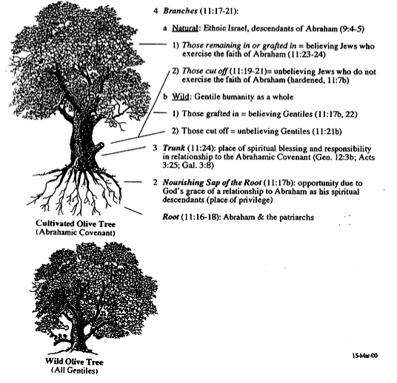

外邦人的移植
枝子 (十一:17-21)
155q
a. 天然: 以色列族 (九:4-5)
1) 剩余/移植 = 相信 (十一:23-24)
2) 被剪断 = 不信 (十一:19-21)
b. 野生的: 所有的外邦人
1) 移植 = 相信 (十一:17b, 22)
2) 被剪除 = 不信 (十一:21b)
树干 (十一:24)
树脂 (十一:17b)
树根 (十一:16-18)
栽种的橄榄树（与亚伯拉罕的约）
Wild Olive Tree
(All Gentiles)

Slide 89
不连续性
155r
课题
以色列
教会
种子
肉身
属灵
帕勒斯坦
之约
部分履行
没有土地的承诺
律法
必须遵守
已得自由
为期
亚伯拉罕到永恒
圣灵降临到被提

Slide 90
不连续性
155r
课题
以色列
教会
愤怒
富有经验的
已得自由
信心
透过献祭
相信基督
祭司职份
有一位
本身就是
活动
分别出来直到第70th 周
在69th 与 70th周
之间，是个迷

Slide 91
不连续性
155r
课题
以色列
教会
条件
伦理:
亚伯拉罕的后裔或行割礼成为犹太人的外邦人
非伦理: “并 不 分 犹 太 人 、 希 利 尼 人”
(加. 3:28)
犹太人以及不需要行割礼的外邦人

Slide 92
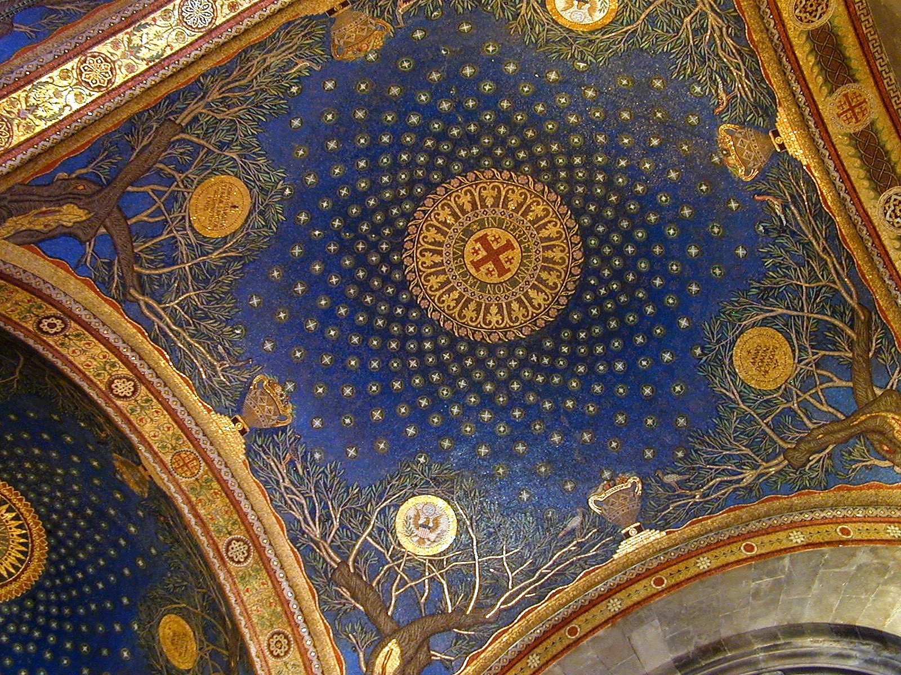
连续性
155s
课题
以色列
教会
亚伯拉罕
起源
领养
大卫的约
圣殿
属灵的殿
新约
应许
部分成就
律法
摩西的律法
基督的律法

Slide 93
连续性
155s
课题
以色列
教会
救恩
得救本乎恩
得救本乎恩
救恩的依据
牺牲的羔羊
牺牲的羔羊
圣灵
在领袖身上
内住所有
先知
展示神的话语
也设立教会

Slide 94
连续性
155s
课题
以色列
教会
拣选
上帝的恩典拣选了以色列
上帝的恩典拣选所有
不顺服
➔管教
➔ 管教
领袖
长老
长老
见证
“光”
“国度”
“圣洁的国民”
“光”
“国度”
“圣洁的国民”
Notes:
“光”
“国度”
“圣洁的国民”

Slide 95

新的约
IN BRIEF
Notes:
95
What is the significance of buying a field?
Leviticus 25:25 says that if a person becomes so poor that he has to sell his land, his nearest relative must buy it.
Anathoth was Jeremiah's hometown four kilometers north of Jerusalem. Since he was the closest relative, God's will was for him to buy the land.

Slide 96

The New Covenant
30
Jeremiah 31:31-34
My Definition: God's unconditional amplification of the blessing promise in the Abrahamic Covenant in which Israel and Judah will experience national and spiritual redemption but in which the church also experiences partial present blessings.
Alternate (Amillennial) Definition: The blessing of the Spirit in the present age given to each believer as the "seed of Abraham" (Gal. 3:7, 16, 29; 4:31) since God has rejected national Israel and replaced it with the church.

Slide 97
四个在圣经里无条件的约
476
亚伯拉罕之约
创 12:1-3
后裔
祝福
土地
土地之约
申 30:1-10
大卫之约
撒下 7:12-16
新之约
耶 31:31-34
新的约是神无条件扩大在亚伯拉罕之约中所承诺的祝福，让
犹大和以色利经历全国性和属灵性的救赎。
Notes:
97
But what's really significant is he needed to buy the field at this time! Why?
Anathoth was in Babylonian hands! Waste money to buy enemy land?!
I bet King Zedekiah was sitting there thinking Jeremiah was a lunatic to even consider this bad debt loss!

Slide 98
新的约CUSPSS
耶利米书 31:31-34
³¹耶和华说：“日子将到，我要与以色列家和犹大家另立新约,
³²不像我拉着他们祖宗的手，领他们出埃及地的时候，与他们所立的约。我虽作他们的丈夫，他们却背了我的约。”这是耶和华说的。
³³耶和华说：“那些日子以后，我与以色列家所立的约乃是这样：
Notes:
98

Slide 99
新的约
耶利米书 31:31-34
^{33下} 我要将我的 律法放在他们里面，写在他们心上。我要作他们的 神，他们要作我的子民。 ³⁴他们各人不再教导自己的邻舍和自己的弟兄说： ‘你该认识耶和华’, 因为他们从最小的到至大的， 都必认识我。我要赦免 他们的罪孽，不再记念他们的罪恶。” 这是耶和华说的。
Notes:
99

Slide 100
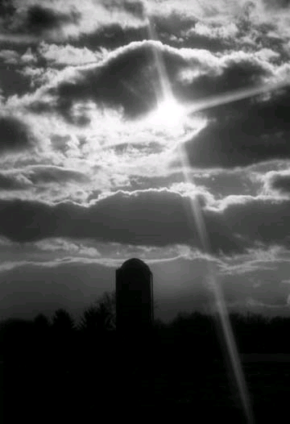
规 定
477
应验
圣灵居住在人的心里
(耶31:33 和 结36:27)
新本质 、心思和意念
(耶31:33; 赛 59:21)
罪得赦免
(耶 31:34下)
未应验
每个人都认识上帝
(耶 31:34上)
以色列和犹大团圆 (耶31:31)
Notes:
100
Years ago at SBC we embarked on an aggressive building project called Project Nehemiah during the huge 1998 economic downturn. People said, "You're crazy! How in the world can you raise the needed S$8.5 million?"
We replied, "We're training 403 students now, but God wants us to train more students and train them better. We're confident that to do this we need a new academic block. Like the biblical Nehemiah, we too must expand."
So even though some said it was a dumb time to build, we built in His name.

Slide 101
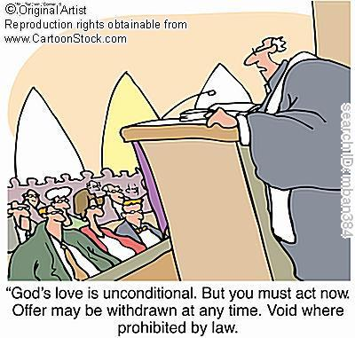
无条件的性质
477
永恒 (耶 31:36, 40; 32:40; 50:5; 赛 61:2. 8-9; 24:5; 结 37:26)
亚伯拉罕之约的扩大，也是无条件的
神毫无保留的 “我愿意”声明 （耶31:31-34， 37）
"神的爱是无条件的. 但你必须立刻行动. 这个优惠可能随时取消. 在被法律禁止的地方无效."
Notes:
101

Slide 102

对履行时间的不同见解
477
千禧年论者（Amillennialists） 常说新约所有的规定现今已在他们认为是“新以色列”的教会中实现了。 但这到底是吗?
1. 部分已经应验在现今的教会
只有一个新约，是给以色列的 (Darby)
两个新约: 一个给以色列和一个给教会 (Chafer)
一个新约，两重应用: 主要是以色列, 其次是给教会
2. 基督再来后就完全应验
Notes:
102
Learn Spanish in school and then minister to Chinese.

Slide 103
国度与契约时间表
22 &
337
9g
国度概念的教导...
基督得胜以色列的仇敌，以色列全家都要得救（罗11:26-27）
亚当与神同掌权（ 创. 1:26, 28; 2:19)
撒旦自以为神统治着这个世界 (创. 3:15;
2 Cor. 4:4)
神与亚伯拉罕立约透过以色列成为“祭司的国度”重新建立人的统治权
(创. 12:1-3; 出. 19:6)
以色列失去祭司国度的见证，于是被掳受外邦统治
以色列拒绝弥赛亚国度的邀请(太. 12:41-42; 23:37-39)
耶稣藉着教会以神奇的方式扩展张他的国度（太.13）
基督与众圣徒一同掌权（弗1:9-10; 启20:1-6; 22:5下）
人的堕落 (创 3)
诺亚之约
创世记 6:18; 9:8-17
土地之约
以色列
教会
弥赛亚国度
民族的焦点)
“新人” (弗2:15)
千禧年永恒
土地
创世记 15:18 (参：申30:1-10)的应许:
从埃及哇地至幼发拉底河流域(赛27:12)
被掳归回／重建之后，土地永久占有权(创17:8)
因着巴勒斯坦地全世界蒙祝福 (赛14:1-2)
以色列因着拒绝弥赛亚受审判被赶逐出应许之地 长达19世纪（主后70－1948）现在部分恢复（结37:1-7）
完全恢复（结37:8-28) 耶路撒冷世界的首府(赛 2:1-5)
新耶路撒冷
(启 21)
大卫之约
基督是教会的头，教会是属灵的圣殿（2:19-22; 林后6:16)
基督作王与众圣徒统治全世界
基督将国度呈递给天父（林前15:24）
亚伯拉罕之约
撒母耳下7:12-16 永久的应许:
儿子 (“家室”永不遭废弃)
国 (政治王朝)
宝座 (后裔接续掌权)
圣殿 (儿子来建造)
创世记 12:1-3
后裔
新约
在民族复兴之际，新约的五个内容均得以实现（亚8）
一切都更新了！
（启21:5）
耶利米书31:31-34 应许:
赦免
圣灵内住
新心，新人，新思想
以色列与犹大重新统一
不需要传福音
新约前三项取代摩西律法（路22:20; 林后3:6)
祝福
摩西之约
十字架废除、成就、取代了律法(罗7:1-6;1 林前9:19-21; 希8:13)
第五版
2015年5月13日
暂时的（加3:19）、有条件的，显明人的罪（罗7:7）并规范以色列人（加3:23-25）
经文突出强调双重国度之约。以色列的角色从亚伯拉罕到基督其内涵延伸至教会（继续中），而教会并非指“新以色列人”（不连续）以便取代以色列民族。
以色列将在基督第二次降临时信靠基督从而再现其世界显赫地位。
Notes:
OS-10-2Sam-96

Slide 104

“新”代替 “旧"
24
Wayne Grudem, 系统神学（Systematic Theology）, 521页
“在基督里，‘旧约’ 和 ‘新约’的对比是什么呢? 它不代表整本旧约圣经, 因为 亚伯拉罕之约 和 大卫之约在新约里都不曾被称为‘旧’. 然而, 只有摩西之约， 那在 西奈山上所立的约 (出 19-24) 才被称为‘旧约’ (林后 3:14; cf. 希8:6, 13)。这‘旧约’在基督里将会被‘新约’取代。 (路 22:20; 林前11:25; 林后3:6; 希 8:8, 13; 9:15; 12:24)。”
Notes:
CH-02-Nature, etc.-104
OS-24-Jeremiah-173
NS-08-2 Corinthians-41
NS-19-Hebrews-298
FU-05-Bliblical Covenants-34

Slide 105
圣约的象徵
166e
圣约 | 定义 | 应许 | 成就 | 象徵
挪亚 | 没条件地应许以后都不再用洪水淹盖地球 | 创 9:12-17 | 没有海 (启 21:1) | 彩虹 (创 9:12-17)
亚伯拉罕 | 应许供应以色列土地，统治及属灵祝福 | 创 12:1-3; 15:13-18 | 持续到今日 (加 3:17) 但以色列还有未来 (看 罗 11:25-27) | 割礼 (创 17:11)
摩西 | 有条件约束祝福以色列 | 出 19-31; 申28 | 基督之死 (罗 7:4-6) | 安息日 (出 31:13)
土地 | 应许从埃及小河直到伯拉河的土地 | 申 30:1-10 | 土地被祝福 (摩 9:13-15) | 没有象徵 (我所知道的)
大卫 | 应许了大卫的后裔永远统治 | 撒下7:12-17 | 统治更新 (摩 9:11-12) | 基督坐在父的右边 (徒 2:34-36)
新 | 应许圣灵的同在 (“律法写在心上”), 饶恕及向全以色列传福音。 | 耶 31:31-34 | 保罗和使徒 (林后 3–4) 全以色列得救 (罗 11:26-27)) | 圣餐的杯 (路 22:20; 林前 11:25)

Slide 106
旧约和新约的差异(哥林多后书 3–4 )
166c
旧约 | 新约
摩西开始的 (3:8) | 基督开始的 (3:4)
凭着字句 (3:6a) | 凭着精意/圣灵 (3:6a, 18b)
死 (3:6b, 7a) | 活(3:6b)
写在石版上 (3:3b, 7a) | 写在心版上(3:3b; Jer. 31:33)
荣光 (3:7a) | 更有荣光(3:8, 10)
荣光退去 (3:7b, 11a, 13b) | 荣上加荣 (3:11b, 18)
定罪的职事 (3:9a) | 称义的职事(3:9b)
欺骗 (3:13) | 大胆 (3:12)
蒙摩西的脸 (3:13b) | 敞着脸(3:13a, 18a)
蒙着心意(3:14a) | 敞着心意(3:14b; 4:3-6)
蒙着心(3:15) | 敞着心 (3:16)
心底刚强 (3:14a) | 自由 (3:17)
摩西返照主的荣光 | 全部信徒反照主的荣光(3:17)
没有改变 (3:7) | 有改变 (3:18)
缺乏热情(3:13) | 自信，坚定 (3:4-5; 4:1)
谬讲 (3:13) | 虔诚 (4:2)

Slide 107

如何协调?
耶利米书 31:31-34 (为以色列)
'永恒的约'
'新的心'
'新的灵'
'和平的约'
'一个约'
路加福音 22:20 (为教会)

Slide 108
新约成就的看法
看法 | 解释 | 流派、学者 | 问题
重述摩西 | 没有新约 | 批判的 -考图里尔(Couturier) -杜麦(Duhm) -施密特(Schmidt) -波特(Potter) | 旧约/新约 本文的特质被忽略 旧约 = 有条件的，新约=无条件的 旧约 = 暂时，新约=永恒 旧约 = 外部，新约=内部 旧约 = 没启动，新约=启动 新约 = 和平，繁荣，避难所，圣灵 (经文一致)
单单教会 | 以色列没参加 | 无千禧年/后千禧年 -亚立施(Allis) -考克斯(Cox) -施密克(Smick) -伯特纳(Boettner) | 把以色列及教会同等化而忽略了旧约的资料 新约的介绍不是旧约的成就 现代需要认识上帝(YHWH)(大使命的需要) 公元70年耶路撒冷 vs. 耶利米书 31:40
166d

Slide 109
新约成就的看法
看法 | 解释 | 流派/学者 | 问题
单单以色列 | 教会没参加 | 其它/经典时代论 -达比(Darby) -汤普森(Thompson) -冯拉德 (von Rad) | 忽略新约资料 - 基督最后晚餐的话 - 保罗的声明 - 希伯来书对教会的应用 2. 忽略圣灵现在的工作
两个新约 | 以色列的新约+ 教会的新月 | 早期二十世纪时代论 -查非(Chafer) -华富德(Walvoord)(旧) -来利(Ryrie)(旧) | 同样的用辞给旧约及新约 以色列/教会的特质太准 饶恕的基本是一样 若两个新约那教会没旧约 教会没有以色列的应许
166d

Slide 110
新约成就的看法
= 这是我的看法
看法 | 解释 | 流派/学者 | 问题
教会参加 | 先是以色列 后是教会 | 其它/现代时代论 -克尔(Keil) -莱姆克(Lemke) -布莱特(Bright) -斯科菲尔德(Scofield) -华富德(Walvoord)(DTS) -来利(Ryrie) (DTS) -阿彻(Archer)(TEDS) -凯撒(Kaiser)(TEDS) -费因伯格(Feinberg)(Talbot) -费毅申(Thiessen)(Talbot) | 支持: 主要完成未来—罗马书11章 处理旧约新约资料 饶恕/圣灵 = 现有的祝福 新约有新律法 反驳以上所有的看法
166d

Slide 111

“这 杯 是 用 我 血 所 立 的 新 约”
(路加福音 22:20）
引述耶利米书 31:31-34
新约取代旧约
教会参与以色列盟约
神没弃绝以色列，圣经也从没注明教会将取代以国 (罗马书 11:1比拟耶利米书 31:35-37）

Slide 112
Black
Notes:
112

Slide 113


教会论链接地址 BibleStudyDownloads.org
免费获得该讲解!
圣经学习下载
Notes:
CH Church (Ecclesiology)

